Slide 1
Color and Human Vision

Slide 2
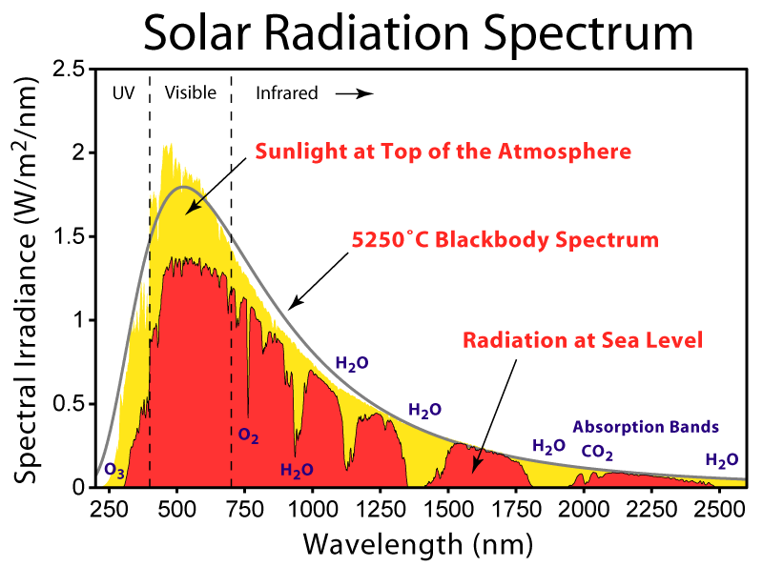

Slide 3
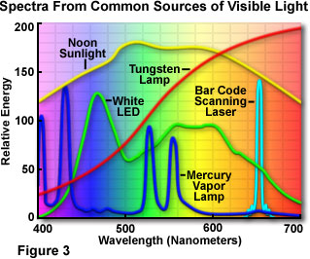

Slide 4
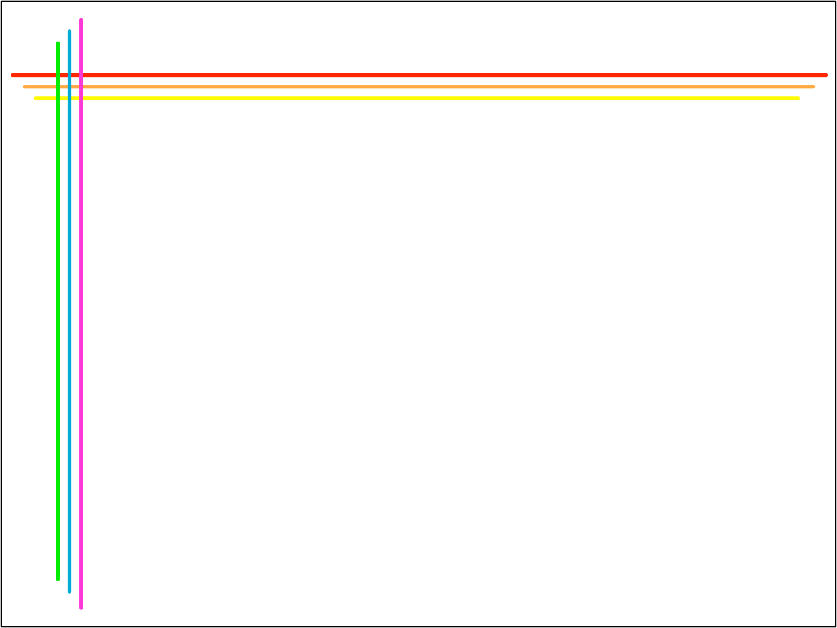
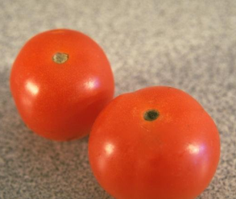
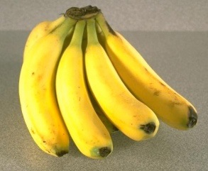
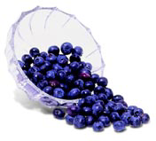
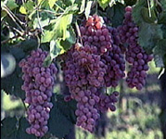
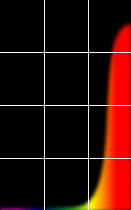
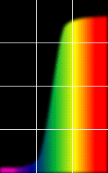
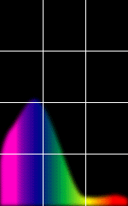
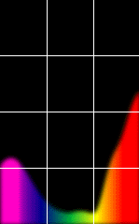
The Physics of Light
Some examples of the reflectance spectra of surfaces
Red
Yellow
Blue
Purple
% Photons Reflected
400 700
400 700
400 700
400 700
Wavelength (nm)
© Stephen E. Palmer, 2002

Slide 5
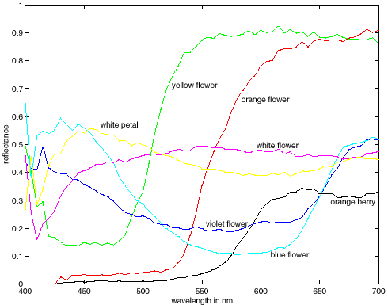
More Spectra

Slide 6
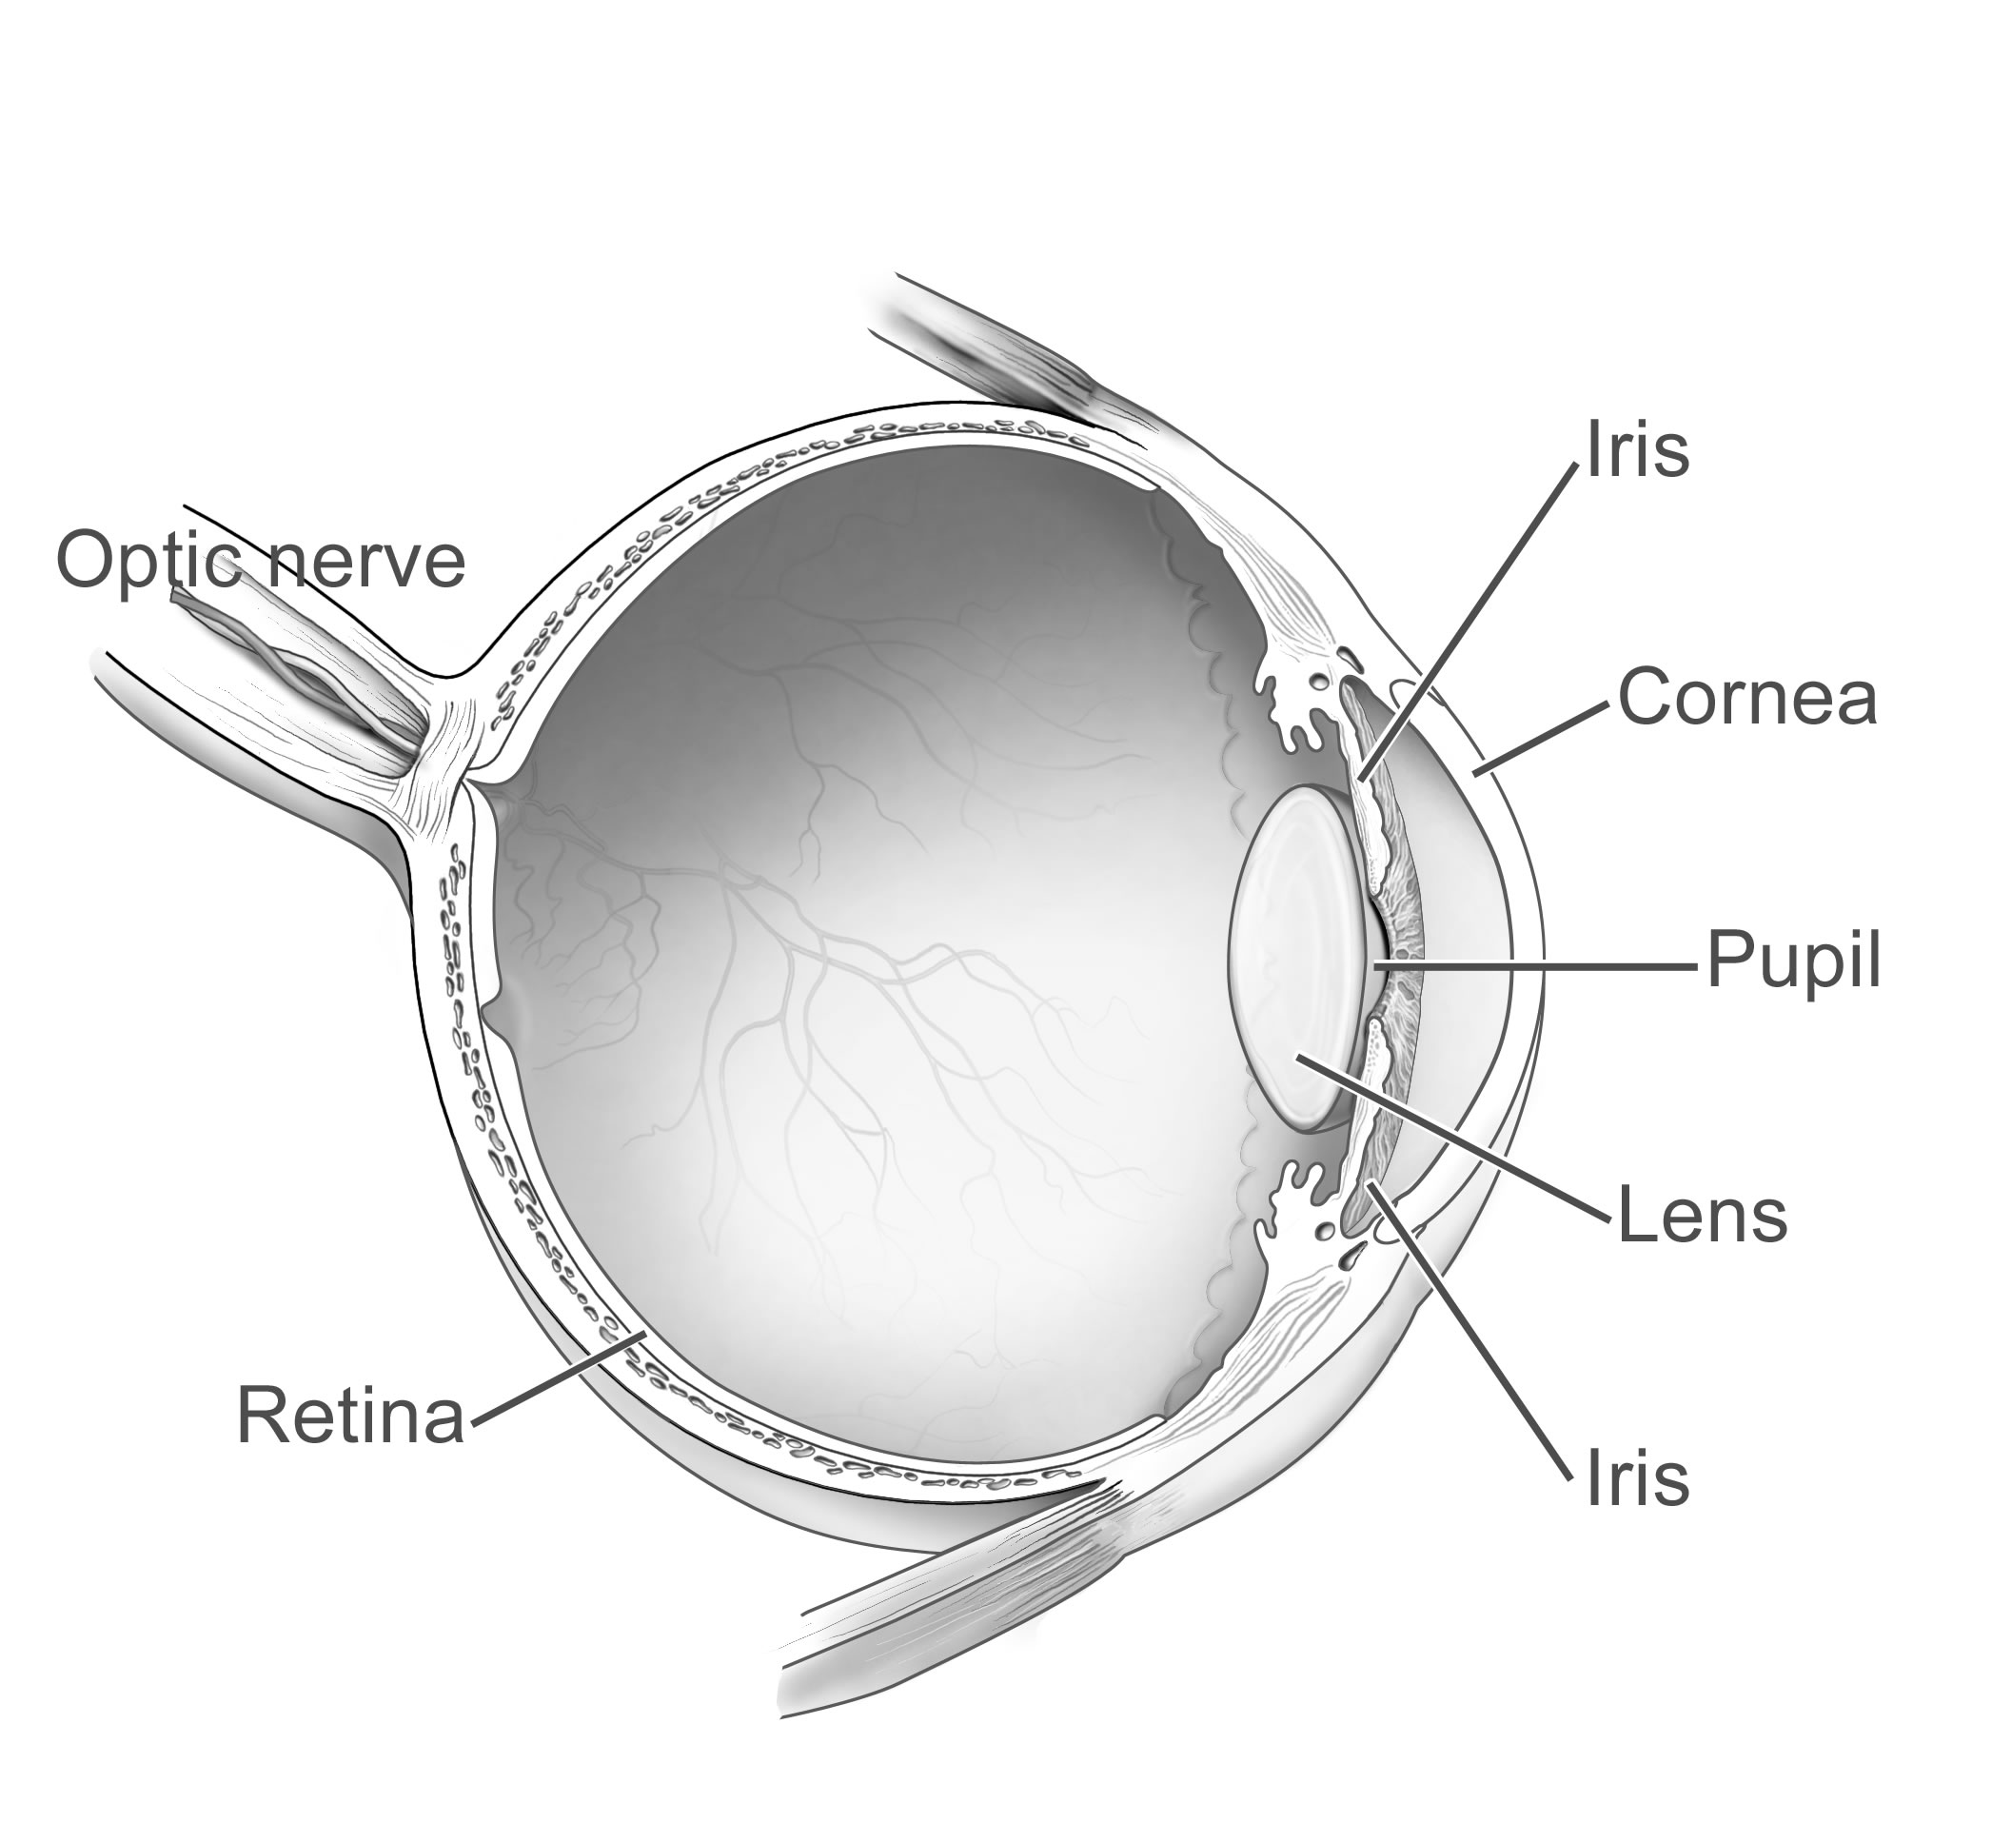
Human Eye
Fovea
Vitrius
Humor

Slide 7
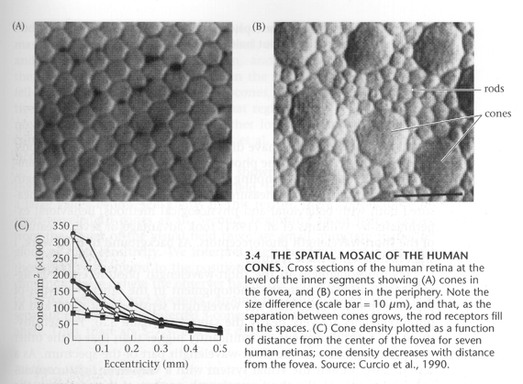
Rods and Cones
Foundations of Vision, by Brian Wandell, Sinauer Assoc., 1995

Slide 8
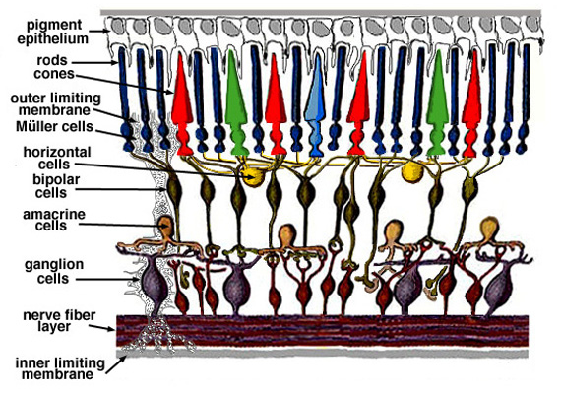
Retina up-close
Light

Slide 9
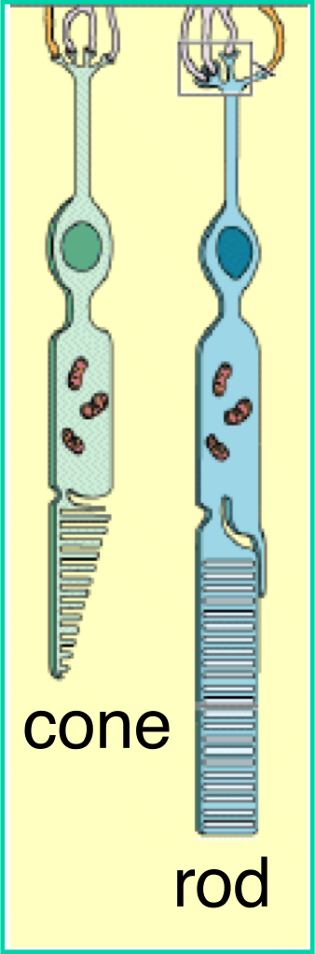
Two types of light-sensitive receptors
Cones
cone-shaped
less sensitive
operate in high light
color vision
Rods
rod-shaped
highly sensitive
operate at night
gray-scale vision
© Stephen E. Palmer, 2002

Slide 10
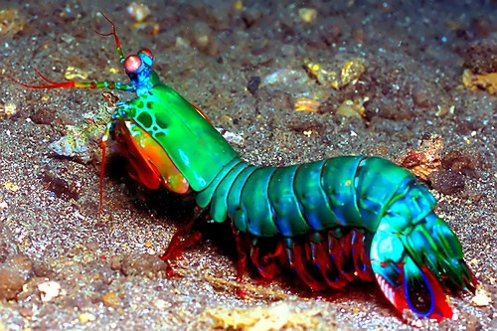

Slide 11
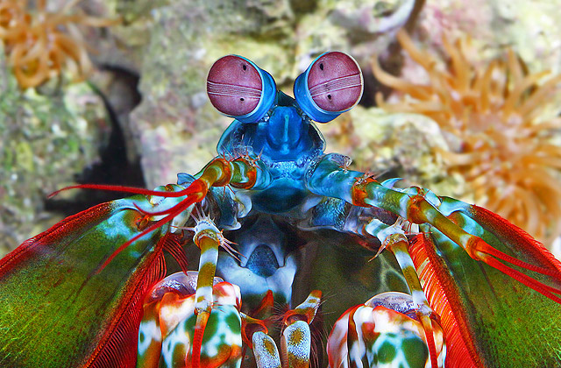

Slide 12
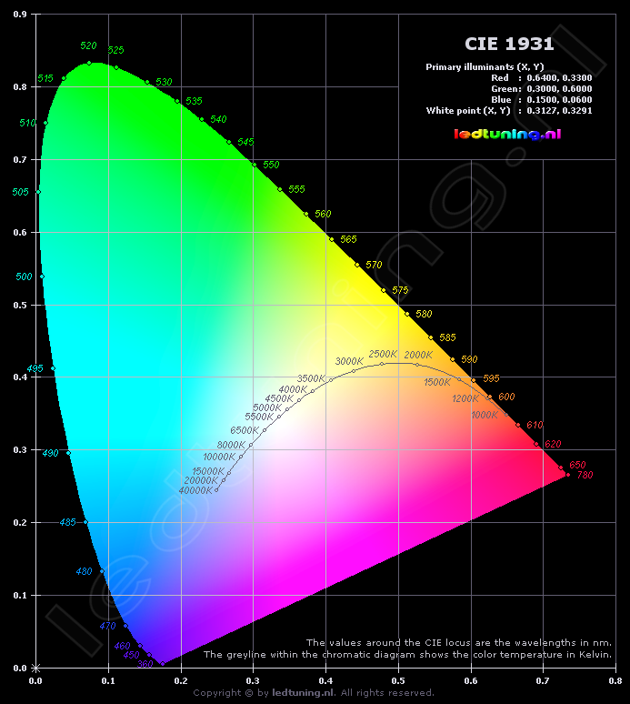

Slide 13
